Slide 1
Unlocking the power of Explainable AI:
Demystifying the Black Box
Session 1:
what is Explainable AI
Notes:
Keeping everything consistent with tutorial proposal. Check your logos please!!!

Slide 2
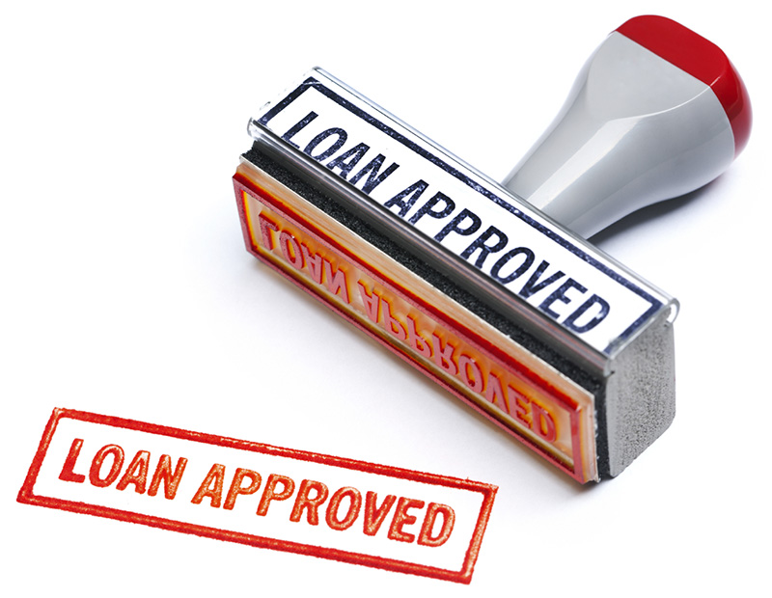



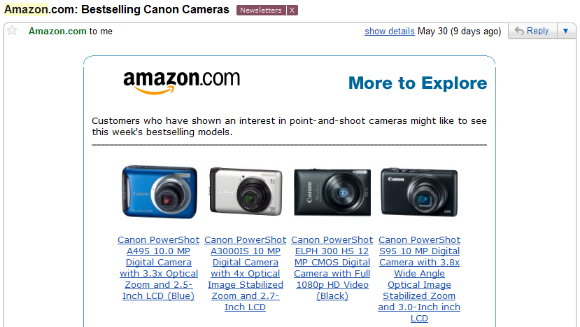
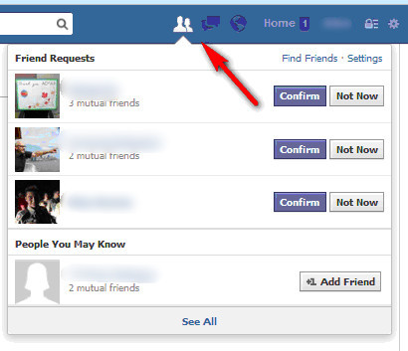
Motivation
[ Weller 2017 ]
Machine Learning is EVERYWHERE!!

Slide 3
Motivation
Model understanding is absolutely critical in several domains -- particularly those involving high stakes decisions!

Slide 4
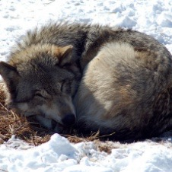



Motivation: Why Model Understanding?
This model is relying on incorrect features to make this prediction!! Let me fix the model
Input
Model understanding facilitates debugging.
Model Understanding
Predictive
Model
Prediction = Siberian Husky

Slide 5


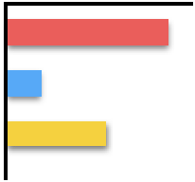

Motivation: Why Model Understanding?
[ Larson et. al. 2016 ]
This prediction is biased. Race and gender are being used to make the prediction!!
Defendant Details
Model understanding facilitates bias detection.
Model Understanding
Race
Crimes
Gender
Predictive
Model
Prediction = Risky to Release

Slide 6

Motivation: Why Model Understanding?
I have some means for recourse. Let me go and work on my promotion and pay my bills on time.
Loan Applicant Details
Model understanding helps provide recourse to individuals who are adversely affected by model predictions.
Model Understanding
Increase salary by 50K + pay credit card bills on time for next 3 months to get a loan
Predictive
Model
Prediction = Denied Loan
Loan Applicant

Slide 7

Motivation: Why Model Understanding?
This model is using irrelevant features when predicting on female subpopulation. I should not trust its predictions for that group.
Model Understanding
Patient Data
25, Female, Cold
32, Male, No
31, Male, Cough
.
.
.
.
If gender = female,
if ID_num > 200, then sick
If gender = male,
if cold = true and cough = true, then sick
Model understanding helps assess if and when to trust model predictions when making decisions.
Predictions
Healthy
Sick
Sick
.
.
Healthy
Healthy
Sick
Predictive
Model

Slide 8

Motivation: Why Model Understanding?
This model is using irrelevant features when predicting on female subpopulation. This cannot be approved!
Model Understanding
Patient Data
25, Female, Cold
32, Male, No
31, Male, Cough
.
.
.
.
If gender = female,
if ID_num > 200, then sick
If gender = male,
if cold = true and cough = true, then sick
Model understanding allows us to vet models to determine if they are suitable for deployment in real world.
Predictions
Healthy
Sick
Sick
.
.
Healthy
Healthy
Sick
Predictive
Model

Slide 9
Motivation: Why Model Understanding?
Utility
Stakeholders
Debugging
Bias Detection
Recourse
If and when to trust model predictions
Vet models to assess suitability for deployment
End users (e.g., loan applicants)
Decision makers (e.g., doctors, judges)
Regulatory agencies (e.g., FDA, European commission)
Researchers and engineers

Slide 10

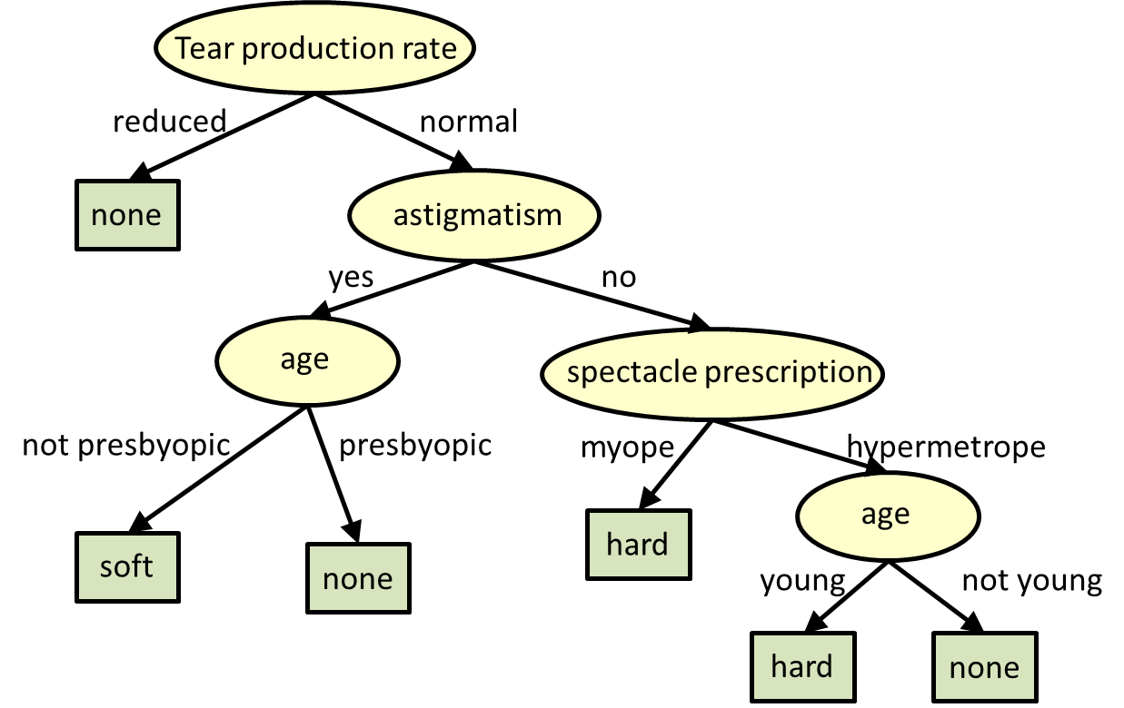
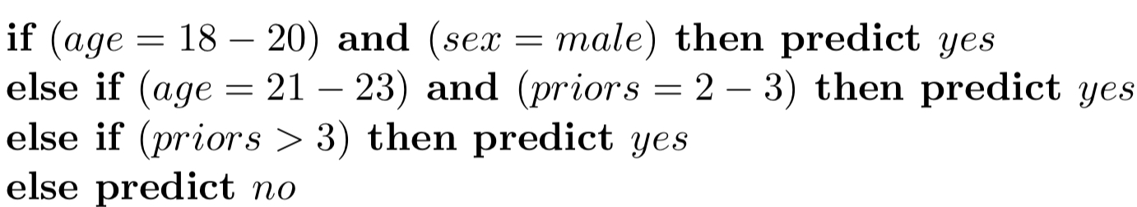
Achieving Model Understanding
[ Letham and Rudin 2015; Lakkaraju et. al. 2016 ]
Take 1: Build inherently interpretable predictive models

Slide 11


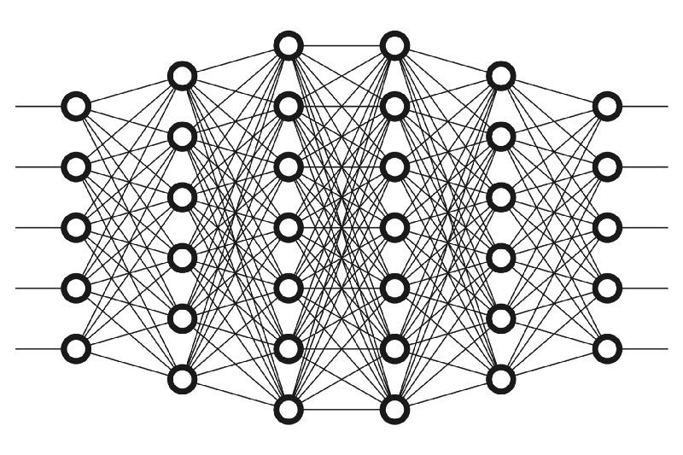
Achieving Model Understanding
[ Ribeiro et. al. 2016, Ribeiro et al. 2018; Lakkaraju et. al. 2019 ]
Take 2: Explain pre-built models in a post-hoc manner
Explainer

Slide 12
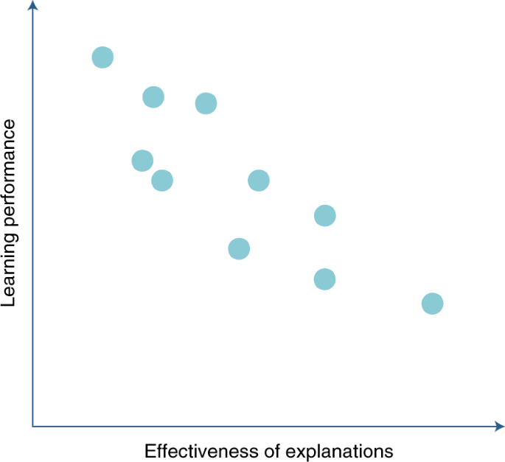
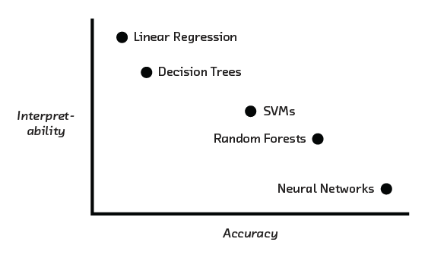
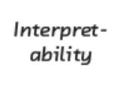

Inherently Interpretable Models vs.
Post hoc Explanations
[ Cireşan et. al. 2012, Caruana et. al. 2006, Frosst et. al. 2017, Stewart 2020 ]
Example
In certain settings, accuracy-interpretability trade offs may exist.

Slide 13
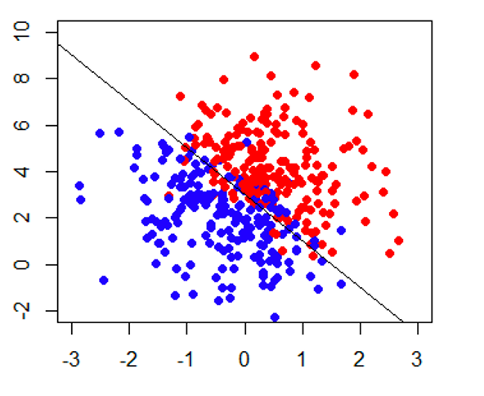
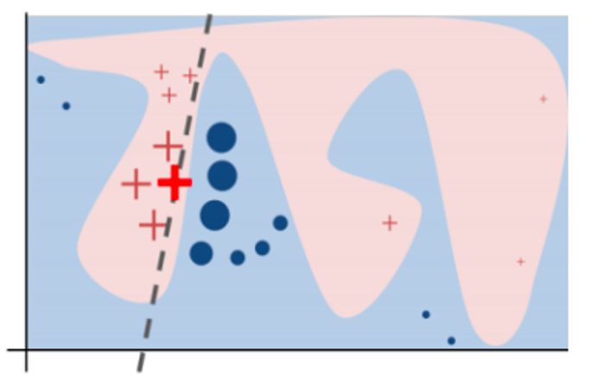
Inherently Interpretable Models vs.
Post hoc Explanations
complex models might achieve higher accuracy
can build interpretable +
accurate models

Slide 14

Inherently Interpretable Models vs.
Post hoc Explanations
[ Ribeiro et. al. 2016 ]
Sometimes, you don’t have enough data to build your model from scratch.
And, all you have is a (proprietary) black box!

Slide 15
Inherently Interpretable Models vs.
Post hoc Explanations
[ Rudin 2019 ]
This tutorial will focus on post hoc explanations!
If you can build an interpretable model which is also adequately accurate for your setting, DO IT!
Otherwise, post hoc explanations come to the rescue!

Slide 16
What is an Explanation?

Slide 17

What is an Explanation?
Definition: Interpretable description of the model behavior
Classifier
User
Faithful
Explanation
Understandable

Slide 18
What is an Explanation?
[ Lipton 2016 ]
Definition: Interpretable description of the model behavior
Classifier
Send all the model parameters θ?
User
Send many example predictions?
Summarize with a program/rule/tree
Select most important features/points
Describe how to flip the model prediction
...

Slide 19
Local versus Global Explanations
Global explanation may be too complicated

Slide 20
Local versus Global Explanations
Global explanation may be too complicated

Slide 21
Local versus Global Explanations
Global explanation may be too complicated
Definition: Interpretable description of the model behavior in a target neighborhood.

Slide 22
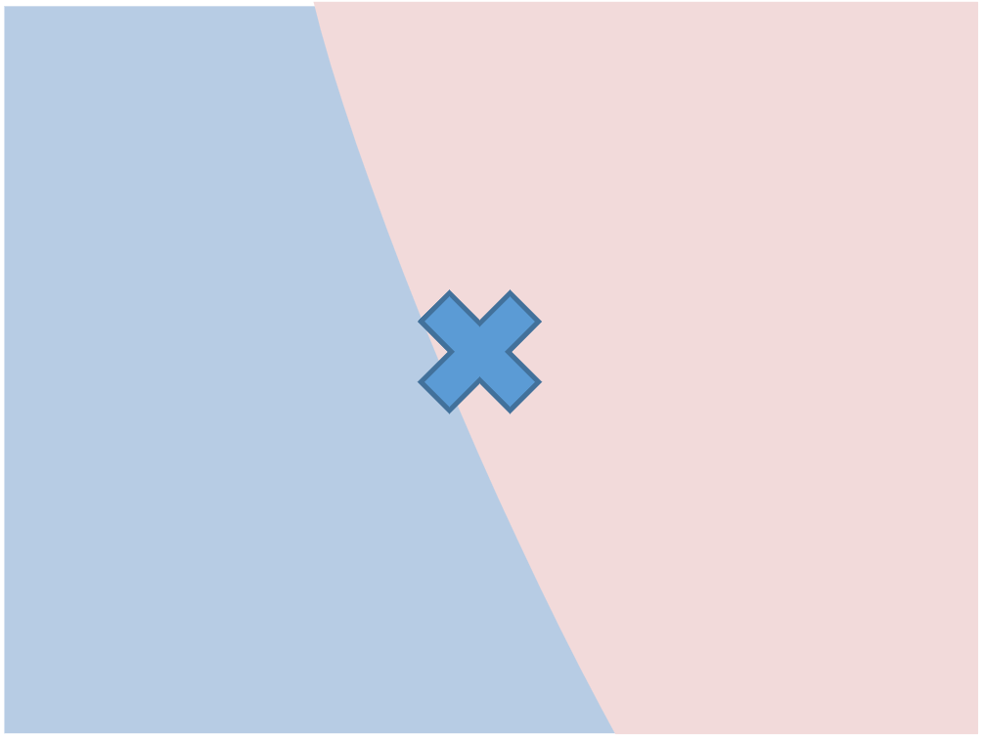
Local Explanations
Definition: Interpretable description of the model behavior in a target neighborhood.
Classifier
User
Send many example predictions?
Summarize with a program/rule/tree
Select most important features/points
Describe how to flip the model prediction
...

Slide 23
Local Explanations vs. Global Explanations
Explain individual predictions
Explain complete behavior of the model
Help unearth biases in the local neighborhood of a given instance
Help shed light on big picture biases affecting larger subgroups
Help vet if individual predictions are being made for the right reasons
Help vet if the model, at a high level, is suitable for deployment

Slide 24





Tutorial on Post hoc Explanations
Approaches for Post hoc Explainability
Explanations in Different Modalities
Evaluation of Explanations
Limits of Post hoc Explainability
Future of Post hoc Explainability

Slide 25
Tutorial on Post hoc Explanations
Approaches for Post hoc Explainability
Explanations in Different Modalities
Evaluation of Explanations
Limits of Post hoc Explainability
Future of Post hoc Explainability

Slide 26
Approaches for Post hoc Explainability

Slide 27
Approaches for Post hoc Explainability
Local Explanations
Feature Importances
Rule Based
Saliency Maps
Prototypes/Example Based
Counterfactuals
Global Explanations
Collection of Local Explanations
Representation Based
Model Distillation
Summaries of Counterfactuals

Slide 28
Approaches for Post hoc Explainability
Local Explanations
Feature Importances
Rule Based
Saliency Maps
Prototypes/Example Based
Counterfactuals
Global Explanations
Collection of Local Explanations
Representation Based
Model Distillation
Summaries of Counterfactuals

Slide 29
Being Model-Agnostic…
No access to the internal structure…
Data
f(x)
Decision
X1 > 0.5
X2 > 0.5
Not restricted to specific models
Practically easy: not tied to PyTorch, Tflow, etc.
Study models that you don’t have access to!

Slide 30
LIME: Sparse, Linear Explanations
[ Ribeiro et al. 2016 ]
Identify the important dimensions, and present their relative importance

Slide 31
LIME: Sparse Linear Explanations
Sample points around x_{i}
Use model to predict labels for each sample
Weigh samples according to distance to x_{i}
Learn simple model on weighted samples
Use simple model to explain

Slide 32
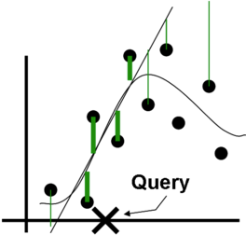
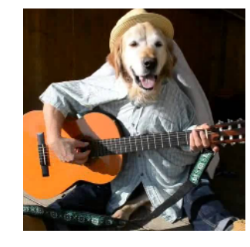
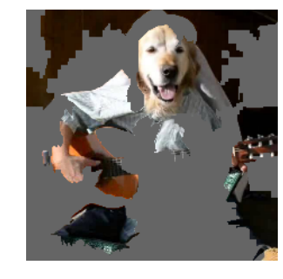
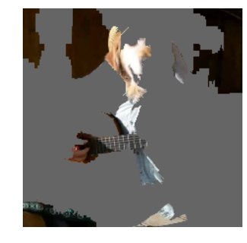
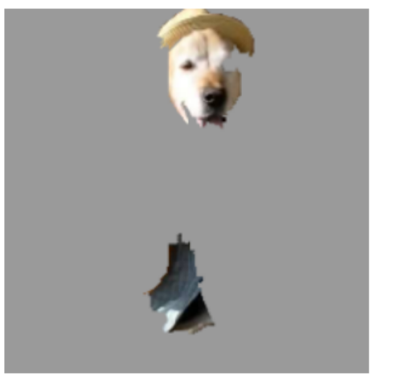
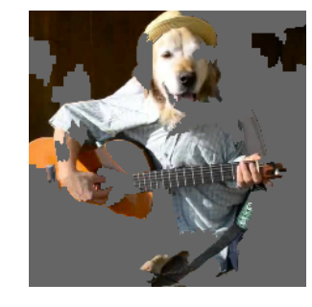
LIME Example - Images
[ Ribeiro et al. 2016 ]
Perturbed Instances | P(Labrador)
0.92
Locally weighted
regression
Original Image
0.001
P(labrador) = 0.21
LIME is quite customizable:
How to perturb?
Distance/similarity?
How local you want it to be?
How to express explanation
0.34
Maybe to a fault?
Explanation

Slide 33
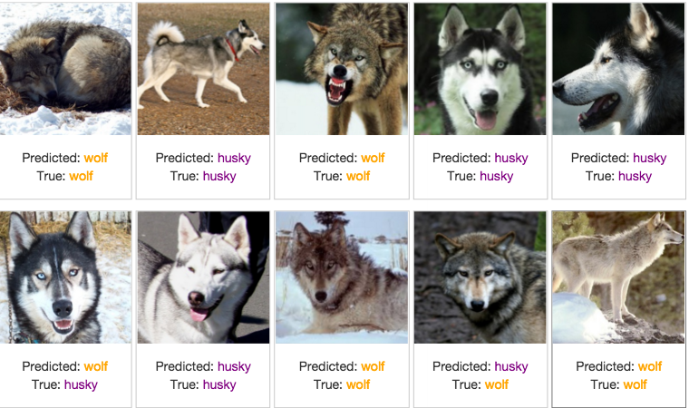
Predict Wolf vs Husky
[ Ribeiro et al. 2016 ]
Only 1 mistake!

Slide 34
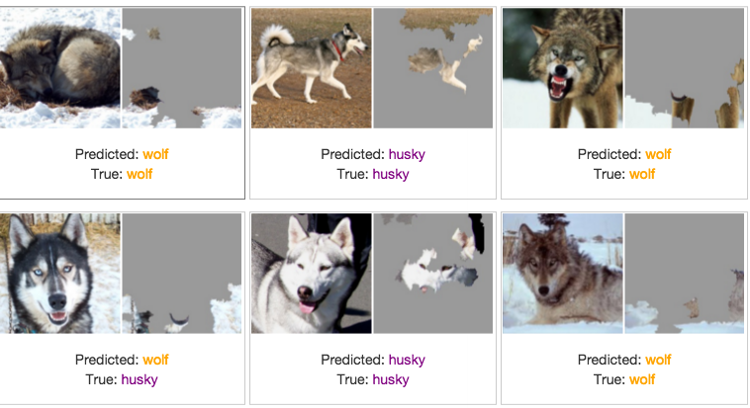
Predict Wolf vs Husky
[ Ribeiro et al. 2016 ]
We’ve built a great snow detector…

Slide 35
SHAP: Shapley Values as Importance
[ Lundberg & Lee 2017 ]
Marginal contribution of each feature towards the prediction,
averaged over all possible permutations.
x_{i}
O
P(y) = 0.9
x_{i}
M(x_{i}, O) = 0.1
O/x_{i}
P(y) = 0.8
Fairly attributes the prediction to all the features.

Slide 36
Approaches for Post hoc Explainability
Local Explanations
Feature Importances
Rule Based
Saliency Maps
Prototypes/Example Based
Counterfactuals
Global Explanations
Collection of Local Explanations
Representation Based
Model Distillation
Summaries of Counterfactuals

Slide 37
Anchors: Sufficient Conditions
[ Ribeiro et al. 2018 ]
Identify the conditions under which the classifier has the same prediction

Slide 38
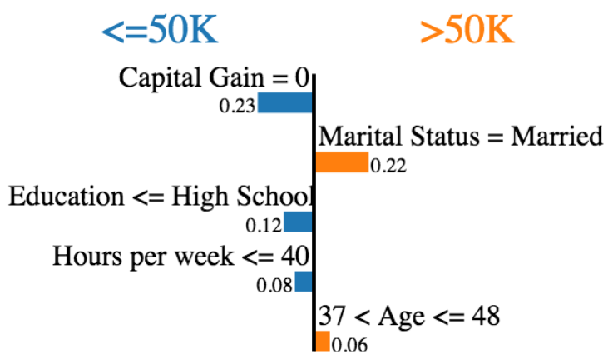
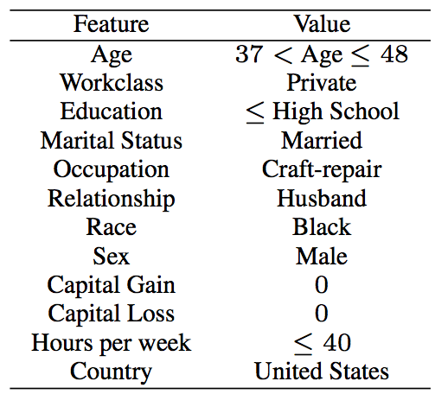
Salary Prediction
[ Ribeiro et al. 2018 ]
LIME
Anchors
Salary
IF Education < High School
Then Predict Salary < 50K
29%
>$50K
71%
<$50K

Slide 39
Approaches for Post hoc Explainability
Local Explanations
Feature Importances
Rule Based
Saliency Maps
Prototypes/Example Based
Counterfactuals
Global Explanations
Collection of Local Explanations
Representation Based
Model Distillation
Summaries of Counterfactuals

Slide 40
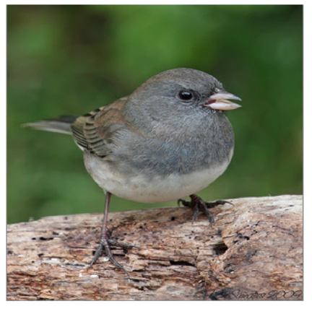

Saliency Map Overview
Input
Model
Predictions
Junco Bird

Slide 41
Saliency Map Overview
Input
Model
Predictions
Junco Bird
What parts of the input are most relevant for the model’s prediction: ‘Junco Bird’?

Slide 42

Saliency Map Overview
Input
Model
Predictions
Junco Bird
What parts of the input are most relevant for the model’s prediction: ‘Junco Bird’?

Slide 43
Saliency Map Overview
Input
Model
Predictions
Junco Bird
What parts of the input are most relevant for the model’s prediction: ‘Junco Bird’?
Feature Attribution
‘Saliency Map’
Heatmap

Slide 44
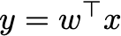
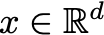
A Linear Model Detour

Slide 45
A Linear Model Detour: Sensitivity
How much does a unit change in an input dimension induce in the output?

Slide 46
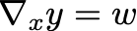
A Linear Model Detour: Sensitivity
How much does a unit change in an input dimension induce in the output?

Slide 47
A Linear Model Detour: Attribution
how can we apportion the output across all the input dimensions?

Slide 48
Another notion of relevance
how can we apportion the output across all the input dimensions?

Slide 49
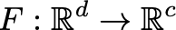
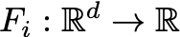
Modern DNN Setting
Input
Model
Predictions
Junco Bird
Model
class specific logit

Slide 50
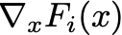
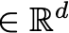
Input-Gradient
Input
Model
Predictions
Junco Bird
Input-Gradient
Same dimension as the input.
Logit
Input
Baehrens et. al. 2010; Simonyan et. al. 2014 .

Slide 51

Input-Gradient
Input
Model
Predictions
Junco Bird
Input-Gradient
Visualize as a heatmap
Logit
Input
Baehrens et. al. 2010; Simonyan et. al. 2014 .

Slide 52
Input-Gradient
Input
Model
Predictions
Junco Bird
Input-Gradient
Challenges
Visually noisy & difficult to interpret.
‘Gradient saturation.’
Logit
Shrikumar et. al. 2017.
Input
Baehrens et. al. 2010; Simonyan et. al. 2014 .

Slide 53
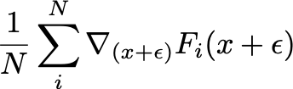
SmoothGrad
Input
Model
Predictions
Junco Bird
SmoothGrad
Average Input-gradient of ‘noisy’ inputs.
Gaussian noise
Smilkov et. al. 2017

Slide 54
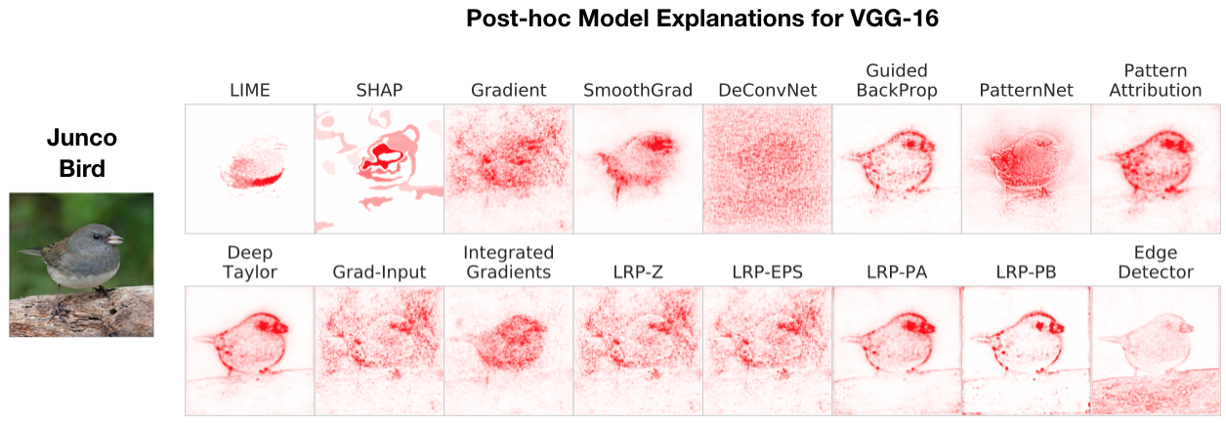
SmoothGrad
Input
Model
Predictions
Junco Bird
SmoothGrad
Average Input-gradient of ‘noisy’ inputs.
Gaussian noise
Smilkov et. al. 2017

Slide 55
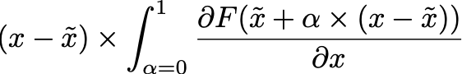
Integrated Gradients
Input
Model
Predictions
Junco Bird
Path integral: ‘sum’ of interpolated gradients
Baseline input
Sundararajan et. al. 2017

Slide 56
Integrated Gradients
Input
Model
Predictions
Junco Bird
Path integral: ‘sum’ of interpolated gradients
Baseline input
Sundararajan et. al. 2017

Slide 57
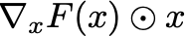
Gradient-Input
Input
Model
Predictions
Junco Bird
Gradient-Input
Element-wise product of input-gradient and input.
Input
Input gradient
Shrikumar et. al. 2017, Ancona et. al. 2018.

Slide 58
Gradient-Input
Input
Model
Predictions
Junco Bird
Gradient-Input
Element-wise product of input-gradient and input.
Input
logit gradient
Shrikumar et. al. 2017, Ancona et. al. 2018.

Slide 59
‘Modified Backprop’ Approaches
Compute feature relevance by modifying the backpropagation.

Slide 60
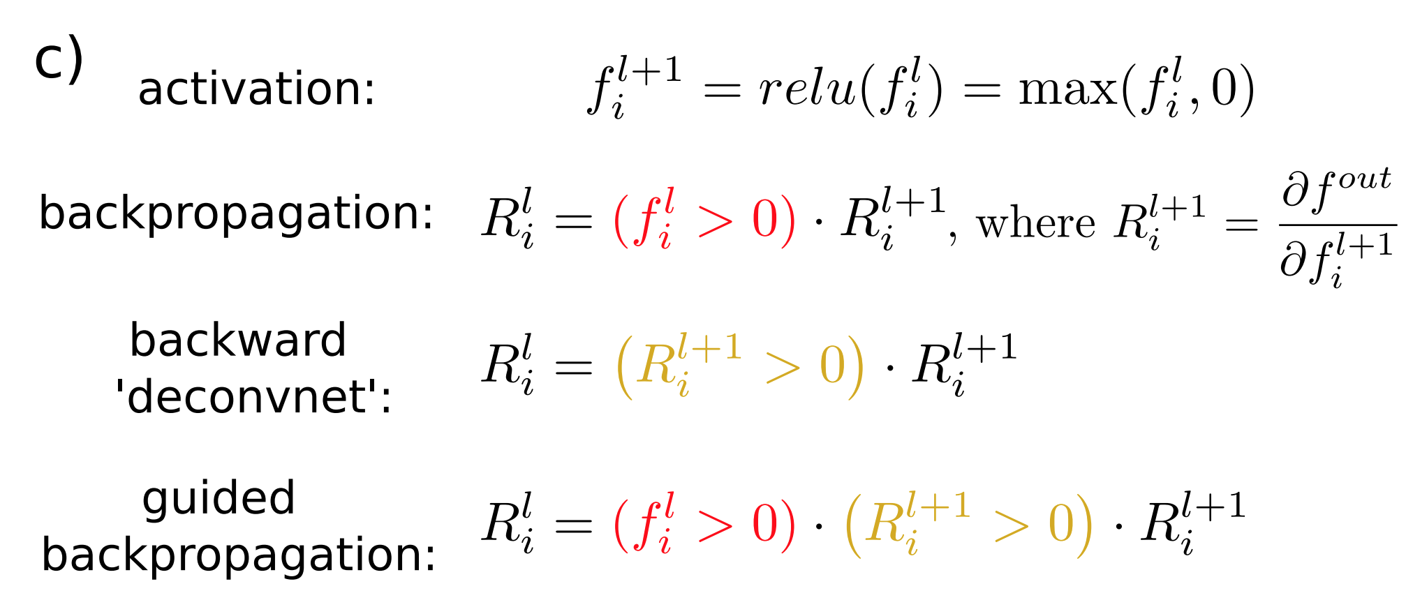
‘Modified Backprop’ Approaches
Compute feature relevance by modifying the backpropagation.
Source: Springenberg & Dosovitskiy et. al. 2015

Slide 61
‘Modified Backprop’ Approaches
Compute feature relevance by modifying the backpropagation.
Source: Springenberg & Dosovitskiy et. al. 2015

Slide 62
Attribution: Guided BackProp
Input
Model
Predictions
Junco Bird
Guided BackProp

Slide 63
Attribution: Guided BackProp
Input
Model
Predictions
Junco Bird
Guided BackProp
Input Gradient

Slide 64
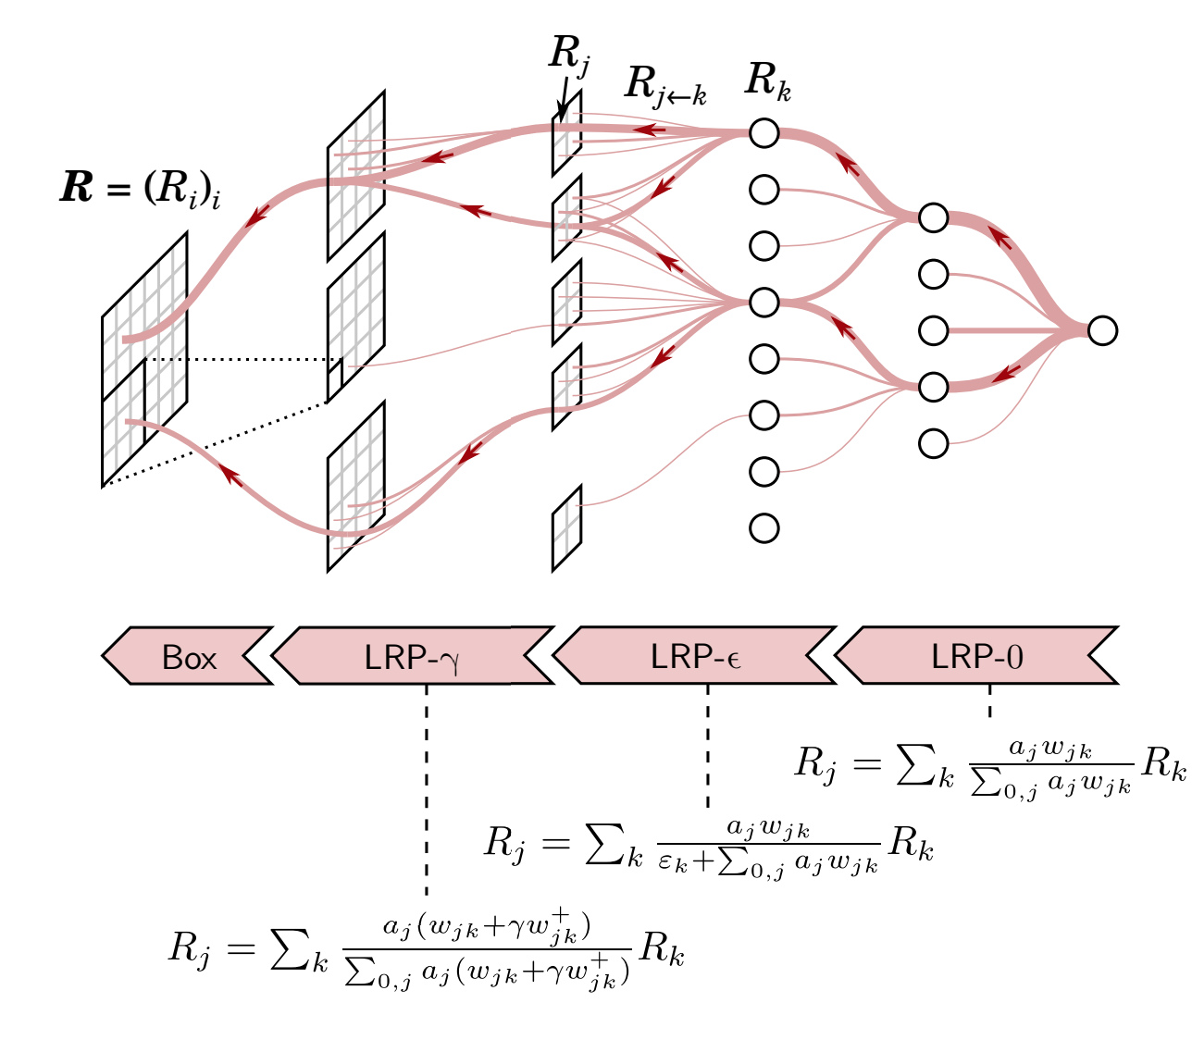
Layer Relevance Propagation (LRP)
Compute feature relevance iteratively and propagate. Different propagation rules can be specified.
Output
Input
Source: heatmapping.org; ECML-PKDD 2020 Tutorial.

Slide 65
Layer Relevance Propagation (LRP)
Compute feature relevance iteratively and propagate. Different propagation rules can be specified.
Output
Input
Source: heatmapping.org; ECML-PKDD 2020 Tutorial.

Slide 66
Layer Relevance Propagation (LRP)
Input
Model
Predictions
Junco Bird

Slide 67
Recap
Input
Model
Predictions
Junco Bird

Slide 68
Recap
Input
Model
Predictions
Junco Bird

Slide 69
Recap
Input
Model
Predictions
Junco Bird

Slide 70
Additional Methods
Class Activation Mapping (Zhou et. al. 2016).
Meaningful Perturbation (Fong et. al. 2017).
RISE (Petsuik et. al. 2018).
Extremal Perturbations (Fong & Patrick 2019).
DeepLift (Shrikumar et. al. 2018).
Expected Gradients (Erion et. al. 2019)
Excitation Backprop (Zhang et. al. 2016)
GradCAM (Selvaraju et. al. 2016)
Guided GradCAM (Selvaraju et. al. 2016)
Occlusion (Zeiler et. al. 2014).
Prediction Difference Analysis (Gu. et. al. 2019).
Internal Influence (Leino et. al. 2018).
See for additional methods: Samek & Montavon et. al. 2020

Slide 71
Approaches for Post hoc Explainability
Local Explanations
Feature Importances
Rule Based
Saliency Maps
Prototypes/Example Based
Counterfactuals
Global Explanations
Collection of Local Explanations
Representation Based
Model Distillation
Summaries of Counterfactuals

Slide 72
Prototype Approaches
Explain a model with synthetic or natural input ‘examples’.

Slide 73
Prototype Approaches
Explain a model with synthetic or natural input ‘examples’.
Insights
What kind of input is the model most likely to misclassify?
Which training samples are mislabelled?
Which input maximally activates an intermediate neuron?

Slide 74
Training Point Ranking via Influence Functions
Input
Model
Predictions
Junco Bird
Which training data points have the most ‘influence’ on the test loss?

Slide 75
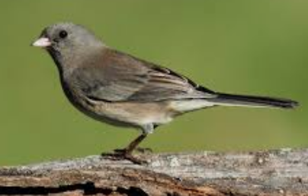


Training Point Ranking via Influence Functions
Input
Model
Predictions
Junco Bird
Which training data points have the most ‘influence’ on the test loss?

Slide 76
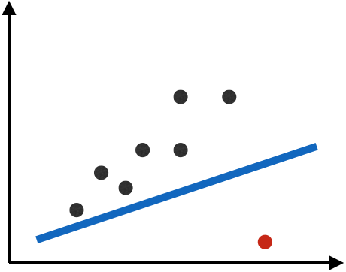
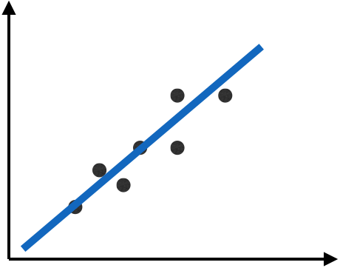
Training Point Ranking via Influence Functions
Influence Function: classic tool used in robust statistics for assessing the effect of a sample on regression parameters (Cook & Weisberg, 1980).
Instead of refitting model for every data point, Cook’s distance provides analytical alternative.

Slide 77
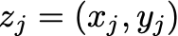
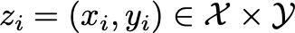
Training Point Ranking via Influence Functions
Koh & Liang (2017) extend the ‘Cook’s distance’ insight to modern machine learning setting.
Training sample point
Koh & Liang 2017

Slide 78
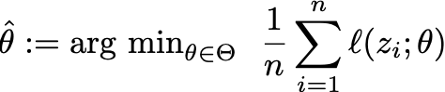
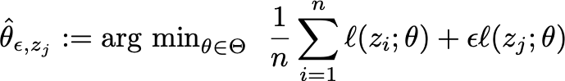
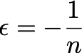
Training Point Ranking via Influence Functions
Koh & Liang (2017) extend the ‘Cook’s distance’ insight to modern machine learning setting.
Training sample point
ERM Solution
UpWeighted ERM Solution
Koh & Liang 2017

Slide 79
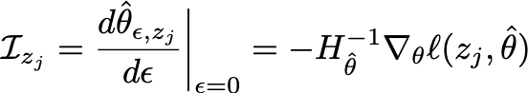
Training Point Ranking via Influence Functions
Koh & Liang (2017) extend the ‘Cook’s distance’ insight to modern machine learning setting.
Training sample point
ERM Solution
UpWeighted ERM Solution
Influence of Training Point on Parameters
Influence of Training Point on Test-Input’s loss
Koh & Liang 2017

Slide 80
Training Point Ranking via Influence Functions
Applications:
compute self-influence to identify mislabelled examples;
diagnose possible domain mismatch;
craft training-time poisoning examples.
[ Koh & Liang 2017 ]

Slide 81
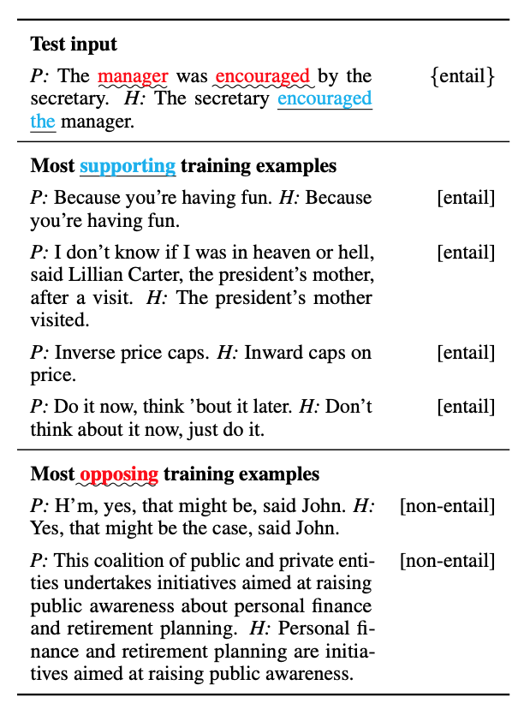
Training Point Ranking: NLP Application
Han et. al. (2020) use influence-based training point ranking to study spurious training artifacts in NLP setting.

Slide 82
Challenges and Other Approaches
Influence function Challenges:
scalability: computing hessian-vector products can be tedious in practice.
non-convexity: possibly loose approximation for deeper networks (Basu et. al. 2020).

Slide 83
Challenges and Other Approaches
Influence function Challenges:
scalability: computing hessian-vector products can be tedious in practice.
non-convexity: possibly loose approximation for ‘deeper’ networks (Basu et. al. 2020).
Alternatives:
Representer Points (Yeh et. al. 2018).
TracIn (Pruthi et. al. appearing at NeuRIPs 2020).

Slide 84
‘Activation Maximization’
These approaches identify examples, synthetic or natural, that strongly activate a function (neuron) of interest.

Slide 85
‘Activation Maximization’
These approaches identify examples, synthetic or natural, that strongly activate a function (neuron) of interest.
Implementation Flavors:
Search for natural examples within a specified set (training or validation corpus) that strongly activate a neuron of interest;
Synthesize examples, typically via gradient descent, that strongly activate a neuron of interest.

Slide 86
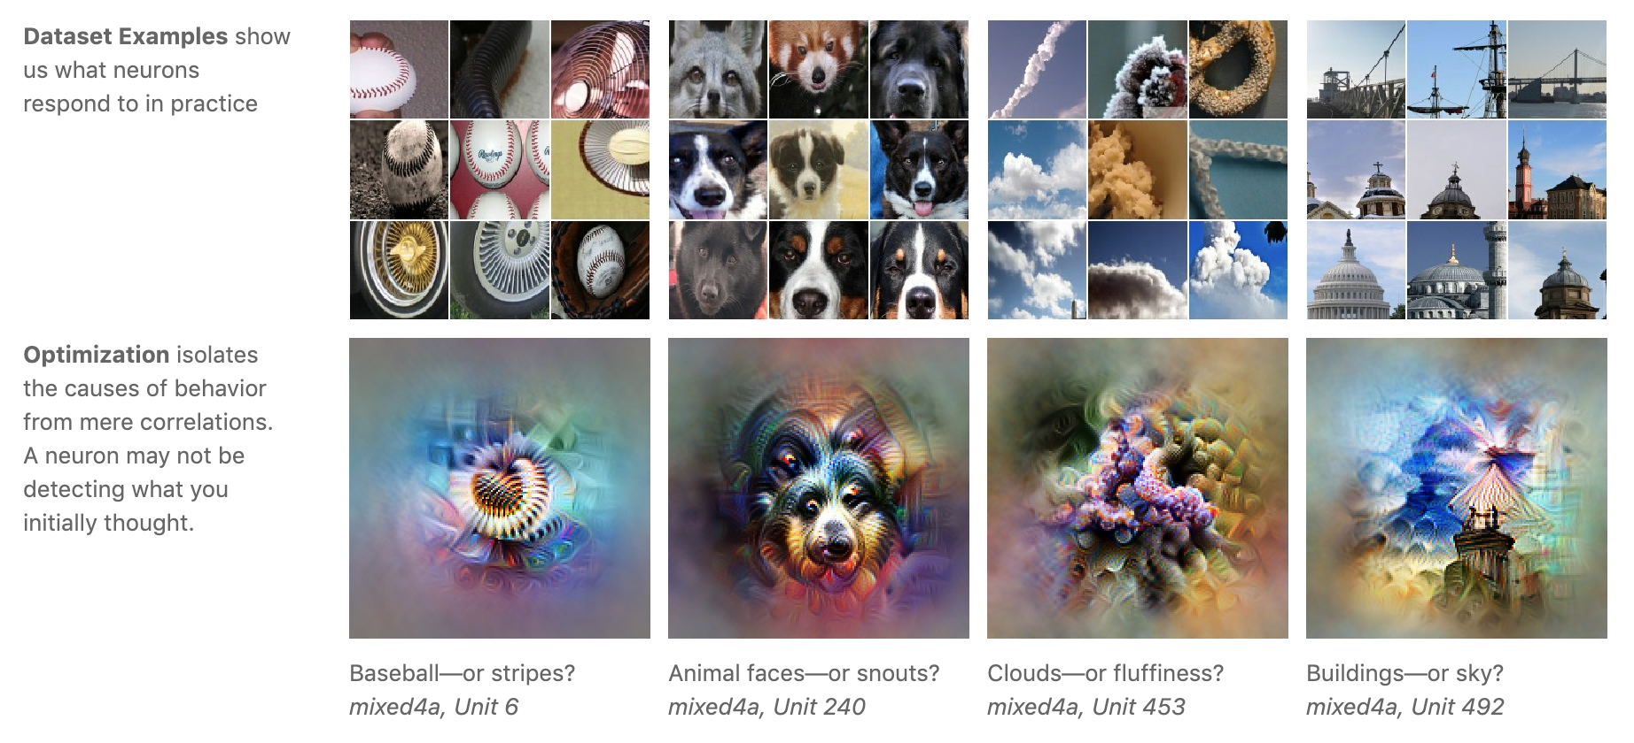
Feature Visualization
Olah et. al. 2017

Slide 87
Approaches for Post hoc Explainability
Local Explanations
Feature Importances
Rule Based
Saliency Maps
Prototypes/Example Based
Counterfactuals
Global Explanations
Collection of Local Explanations
Representation Based
Model Distillation
Summaries of Counterfactuals

Slide 88
Thank you

